Slide 1
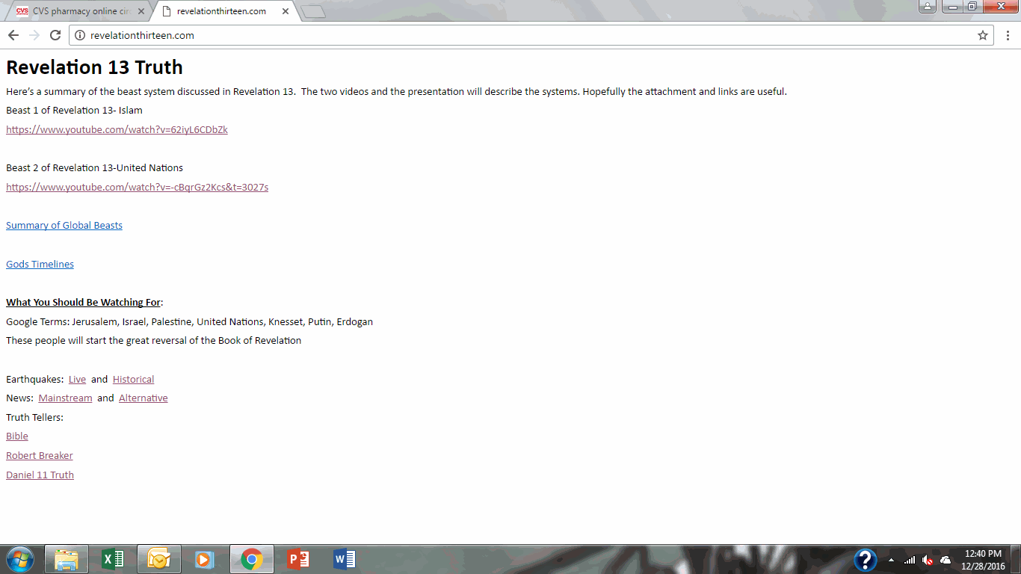
RevelationThirteen.com
This commercial has been bought and paid for by the blood of Christ. No rights reserved.

Slide 2
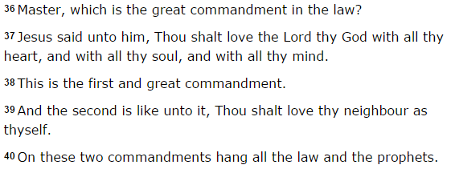
Why God and Why Christ?
We essentially choose whether we want freedom or slavery
God sent his son to die so all may live, something shared by no other religion
God’s philosophy was always constant, what Jesus preached in the gospel was commanded in Genesis 12 (Go forth and make disciples)
Gods law existed in easy format (10 commandments), complex format (Torah), or simple format (Matthew 22:36-40)

Slide 3
Daniel’s 70th Week
God’s Timeline
Pre-Flood (Age of Sin)
Post-Flood (Age of Law)
Post Christ (Age of Grace)
Millennial Reign
~4000BC-2000BC
~2000BC-32AD
~32AD-Present
Millennial Reign
Redemption: Profess Christ as Savior- Rapture to New Jerusalem
Dead in Israeli Law- Resurrected at First Resurrection
Daniel’s 70th Week (Daniel 11 & 12)
Abomination 2: Antichrist Declares Himself God
God’s Bowls of Wrath
Abomination 1: Take Jerusalem/Peace Treaty
1260 Days of Witness
1290-1335 Days
Redemption: Die for Christ Before Day 1335 (Rev 20)- First Resurrection
Die at Winepress Day 1335 (Rev 14)- New Jerusalem
Millennial Reign
144,000 Start
Jeremiah 30-31:33
Hamongog (Ezekiel 39)
New Temple
(Ezekiel 40)
Satan Loosed
Revelation 20
First Resurrection
Ezekiel 37-39
Revelation 20
Second Resurrection/ New Heaven
Revelation 20-22

Slide 4
Matthew 24:6-8 “And ye shall hear of wars and rumours of wars: see that ye be not troubled: for all these things must come to pass, but the end is not yet. For nation shall rise against nation, and kingdom against kingdom: and there shall be famines and pestilences, and earthquakes, in divers places. All these are the beginning of sorrows.”
Global Gospel=Global Beasts
World War I:
1914-1919
Ottoman Empire Destroyed
League of Nations Established
Jewish Nationalism Beginning
World War 2:
1941-1945
Muslim Nations Rebuilding
United Nations Established
Jewish State Created Post War
World War 3:
Coming Soon
New Ottoman Empire Created
United Nations Global Reach
Jewish State Restored/Destroyed
War Event:
Years
First Beast:
Islamic Caliphate
Second Beast:
United Nations
Revelation Tie In:
Jewish Zionists

Slide 5
Paths to Redemption
Law- Through the practice of Old Testament Law prior to the Rapture, or faith/testimony in Christ during the Tribulation
Blood- Through Christ’s sacrificial gift prior to the Rapture, or through the Great Harvest in Revelation 14
The Law was never replaced, rather fulfilled by Christ’s sacrificial death
Jews and Christians will be in both heaven and Earth during the millennial kingdom
Salvation during the Tribulation will require full humility and submission to the Lord

Slide 6
Paths to Redemption, Part 2
Law- Eventual Destination- Restored Israel in Earth
  The millennial reign is a time for the nation of Israel to know Christ through the law on Earth, it’s also a safety net for Christians/Jews who died for testimony during the Tribulation (Revelation 21)
Blood- Eventual Destination- Heaven
  The millennial reign will be a time where the people of Christ can know the Father through the son (Revelation 7), it’s also a gift to the prodigal children who make it through the Tribulation to the Great Harvest of Revelation 14
This is the only path that unites the Old Testament and New Testament, fulfilling the Prophecies of Old Testament with those of the New Testament
It’s also the only path consistent with the teachings of Christ, prophecy, and the Wisdom literature of the OT (whose unity show the authorship of God himself)

Slide 7
Paths to Redemption, Summary
Rapture/Jewish Remnant- Elect Christians placed in heaven and 144,000 Jews are sealed (Rev. 7)
Death for Christ- Revelation 21, Resurrected at the first resurrection for 1,000 years in Restored Israel
Great Harvest- Revelation 14, Destroyed in the Great Winepress, Up in Heaven with Raptured Believers at day 1335
Millennial Reign- All Israel Raised to Inheritance on Earth under Christ (Daniel 9-12, Jeremiah 29-32, Ezekiel 37-39)
Final Judgment- All else judged based on works/not faith
This is the only way for all nations and peoples to be judged equitably and fairly
All is consistent with the original prophecies and wisdom literature/words of Christ/Apostolic teachings

Slide 8
What’s Going to Happen in US?
In Christian areas, where love is present- a battle between love and law will persist
The US and England are the two heads of the 2nd Revelation 13 Beast (United Nations) who voted for Brexit and Trump
In the US, once the Rapture occurs, it will be social justice activists against law and order advocates
Social justice activists will likely win and succumb to the pressure of a United Nations agenda (the Second Beast or as conspiracy nuts call it “the NWO”)
The United Nations will enforce a mark of the Beast that will be required to buy and sell
DO NOT TAKE THE MARK…Hell is certain upon those taking it, all Spirit of Goodness will leave you
There is no turning back from the Mark of the Beast, You only have to resist for 45 days (which will probably seem like eternity in hell on Earth) 1290-1335 days per Daniel 12

Slide 9
So Who is the First Beast?
Given the details of Daniel, the First Beast will be a restored Islamic Caliphate
The Antichrist is most likely to be Recep Tayyip Erdogan from Turkey
His political system is a democratic dictatorship whereby the majority rules under an authoritarian leader
This system is the satanic counterfeit response for how to deal with love and law
Unfortunately with no law, people will act lawlessly (liberal Christians who accept sin)
Unfortunately with only law, people will not have compassion (Israel, Ritualistic Christians)
This is why Islam will conquer Christian nations during the Tribulation

Slide 10
How do you know its Islam?
Three monotheistic faith structures of which:
  Two worship the God of Abraham, Isaac, David, and Jesus, the God of Truth
    One who denies Christ as fulfillment of the Law: Israel
    One who believes Christ fulfilled the Law: Christians
  One worships Allah, who declares himself as the ultimate deceiver in the Quran
You will know them by their works
  US & Christian Nations- Charity, UN of Peace
  Israel- Pride
  Islam- War, UN of Control (It’s happening now)
Abrahams sin was not trusting God-
  Blessing: Isaac with Sarah (Christianity)
  Curse: Ishmael with Hagar (Islam)

Slide 11
Three Monotheistic Faiths
Judiasm
God (Yahweh)
No Son
Blend: Messianic Jews
God is same
Son accepted
Scripturally Sound!
Blend: Hatred
God not same
BLASPHEMY!
Christianity
God (Yahweh)
Son (Christ)
Blend: Chrislam
God not same
Son not same
BLASPHEMY!
Islam
God (Allah)
No Son

Slide 12
How do you know it’s Islam, Part 2?
The tenets of Islam are in direct contradiction to the Scripture
  They deny God as the Father, but rather Allah
  They deny the death and crucifixion of Christ, our Savior
  They require a pilgrimage to Mecca, where the Kaaba is the house of idols
  They are required to recite the Shahada which deny God and Jesus and worship Allah and his prophet Muhammad (False Prophet….wink wink….)
The spoils of Revelation 18:12-13
  These directly tie to the main exports of the Ottoman region
  All drank of the wine of her fornication- OIL!!
The saints were killed by the Ottomans
  And they still are!
Islamic Eschatology is the Reverse of Daniels 70th Week, Islam Expects World Conquest, but derived their lie from the truth of Scripture

Slide 13
How is this to play out?
Understanding that Revelation is actually a test for the righteous, encoded by using Jewish history and the flaws of Christian churches in Turkey, it’s fairly clear
The first battle will be religious- Christians and Jews will have to overcome Islamic manipulation
Christians will have to deny Chrislam and Ecumenalism and trust in Jesus and God alone
Israelites will have to deny liberal laws and accept that Christ is the one true savior
Don’t take my word for it: Two olive branches (most likely Moses and Elijah) will tell you the same while your two safest places will be the US and England
If you pass this test, you will be resurrected with Israel in the First Resurrection on Earth or with Raptured Christians in Heaven

Slide 14
How is this to play out for the remainder?
The end of Daniel Chapter 11 says the Beast will receive news from the north and east that will trouble him
What does that mean? Europe and Americas are likely overtaken by the UN and Islam (large caliphate)
The general political atmosphere is democratic dictatorship (Erdogan’s party of contradiction)
The east and north (Russia and Asia) will likely lead an antichrist versus atheist battle in Armageddon for global power
With nuke bombs, this can easily be done in 7 years from today

Slide 15
To Recap
Daniels 70th Week will Occur post Rapture when Israel becomes Overcome by Islamic Forces (Matthew 24:15, Mark 13:14, Luke 21:20, Daniel 11:31, Daniel 12:11-12)
The Abomination is Probably Islamic Takeover of Jerusalem with multiple 1260, 1290, and 1335 day relationships
  Dome of the Rock- 688 (Abomination)
  Israel Restored- 1948 (1260 years)
  Iran and Shiites Restoring- 1978 (1290 years)
  End of Tribulation- 2023 (beginning of 2017 starts Tribulation?)
The Same Relationship will Occur in the Tribulation Week (God’s the greatest mathematician and pattern maker)

Slide 16
Wisdom Beyond My Means
Whose Likely to Be Saved in Tribulation?
  People need to recognize that heaven cannot exist unless the needs of others exceed the needs of self and an all good God is in control
  You’re only chance at salvation is God’s mercy and Christ’s sacrifice (the only Philosophical option)
  Both love and the law are necessary, that’s why Paul’s (law-Jewish) and John’s (love-Christian) churches had most New Testament coverage
  Most likely: Half Hearted Christians and Jews Particularly those with Missing Family members
  Likely: Liberal Christians and Devout Jews who can release pride of self or pride of law/history, Atheists
  Rare: Islamic People who thought Islam was Religion of Peace

Slide 17
More Wisdom Beyond My Means
How can I tell if a structure is led by God or Satan?
  Satan runs through power structures that are pyramid shaped with all power at the top
  Satan focuses on liberalizing an agenda, which often focuses people on selfish goals/pride and a system that establishes it
  Satan is focused on destruction, in order to rebuild a system of slavery that is masked in free will (Facebook, iPhones, Pokemon Go, Islam, Black Lives Matter)
  Satan is focused on purchasing something rather than getting it for free, while God’s Kingdom is free and purchased without our works/money (God’s grace)
  Anything that takes your attention away from the recognition of God’s presence is an idol, while sin is action against your creator or another individual/spirit
  True churches aren’t governmental
  Salvation, knowledge, and faith are free (tithes, etc., aren’t required)

Slide 18
Even More Wisdom Beyond My Means
How do I know we are at the doorstep of the Rapture?
  The greatest divide in 50/50 splits has occurred
    Brexit (Stay in EU or Leave)- Voted Leave
    US President (Trump v Clinton)- Voted Trump
    Arab Spring (Complete Civil War zone- Turkey/Iran rising)
    Palestine and Israel (Palestine favor switching back to Israel)
  Given pride of the religious, for a complete 50/50 bombshell to occur since Beast 1 and Beast 2 thought they have a “soft kill”, would be for the US to move their Israel embassy to Jerusalem
    Beast 1: Islam-War is Imminent
    Beast 2: UN- Russia Takes Leading Role as Islamic led UN takes over
    Rapture???

Slide 19
Wisdom in Genealogies
How do I debunk bad Christian views? Genealogies
  God created the earth in six literal days and included the genealogies from Adam to Israel to show his pattern of 7 and perfection
  We inherit the sins of our fathers, hence my dad gets to confront his best and worst traits in me and my siblings and vice versa (the original curse of the Fall)
  Families have been God’s transmission of the Word and values since creation (hence the good out of bad family lines have the option of salvation)
  All of Prophecy relates to generations because good and bad blood transmits over time, hence while we hate stereotypes, they are often true generally speaking and not absolutely speaking
  Man and woman were in Jesus’ bloodline (as was Mary), Islam tracks back to Abraham’s sin with Hagar

Slide 20
Final Bit of Wisdom
Why did God pick the Jews as his chosen people?
  PRIDE!!
  How else could a people go through 2,000 years of miracles and 2,000 years with their prophesied Savior and still worship law and the teaching of their Fathers?
  He wanted to maximize the harvest of non-Jewish people before the second coming of Christ and the Rapture
  Israel’s Pride and Christian Pride is what gets broken in Revelation, so God can be with his chosen people
  But before you think anti-semetically, they are the most faithful and adhering people too
    We can thank Paul (Jewish convert) for most New Testament writings
    We can thank Abraham and all generations for Jesus Christ too
    We can thank Israel’s record keeping for accurate transmission as well

